Slide 1
Cell Behaviour Modelling Platform
Ryan Carey, Lewis Kindeleit, Antoine Messager

Slide 2
Design aims
Flexibly & efficiently
reproduce biologically realistic behaviour
Graphical or prompt
Graphical or binary
2

Slide 3
Agent-based models (ABMs)
Suited to modelling interdependent modules (e.g. cells)
Flexible
Can model heterogenous entities with heterogenous interaction network. (Kaul 2015)
Growing in popularity
3

Slide 4

Design choices
Agent-based models
Continuous space
Different types of cells
Environment modelled with PDEs
Julia Language
4

Slide 5
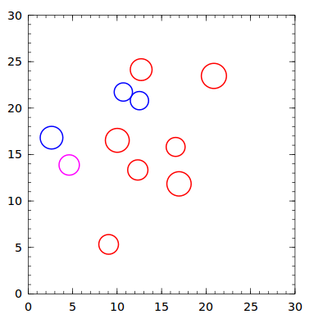
Model overview I
5

Slide 6
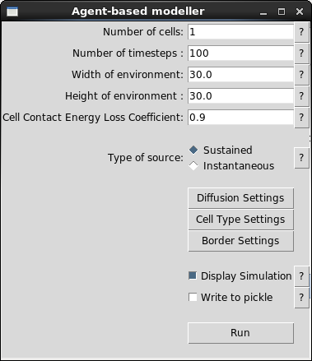
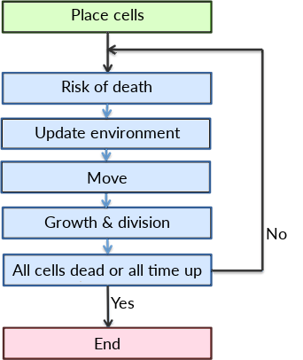
Model overview II
6

Slide 7
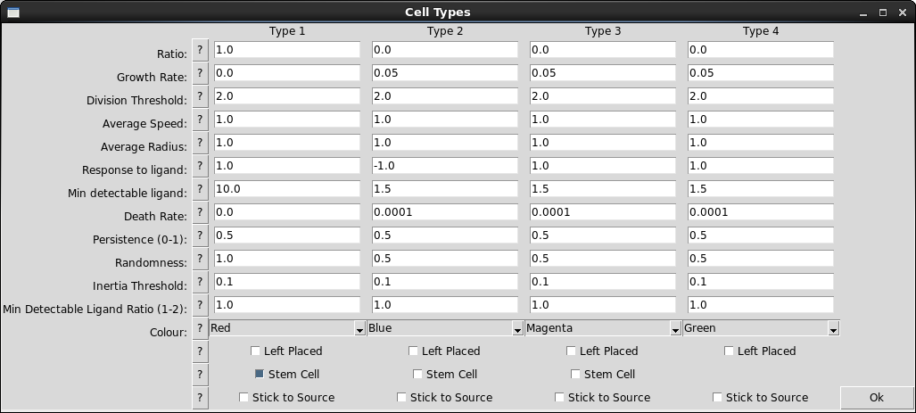
Cell Model Interface
7

Slide 8
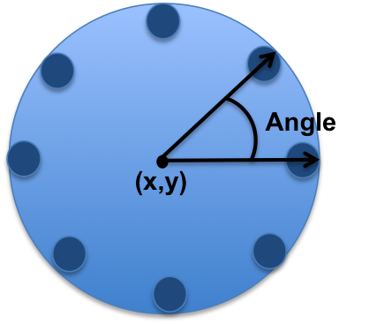
Cell Model
Parameters:
Randomness
Persistence
Thresholds:
C_{max}/C_{mean} < Detectable ratio
C_{max} < Inertia threshold
Schema of the cell
8
Notes:
I am first going to explain how cell moves, then how we can make them bounce against other cells or against walls and finally I am going to explain how the environment is modelled
Cells move according to ligand concentration. They have a input number of ligand receptors as illustrated on the schema. We have assumed that cells go toward the direction with the highest ligand concentration. The concentration is captured by ligand receptors. We want to model here the choice of the direction of the movement.
We used a Persistent Bias Random Walk model for cell movement. Therefore we have introduced two parameters the user can specify. The user can increase the randomness of a specific cell type and choose how much he wants the movement to be persistent.
Since cells may be limited in how much ligand they can detect, we give the user the option of specifying thresholds to make cell choose its direction correctly.
The concentration ratio between the highest concentration divided by the mean concentration needs to be above the detectable ratio
The maximum concentration needs to be above the inertia threshold, we assume that the cell is then within the niche
If the concentration does not reach both thresholds the cell will have a persistent random movement. No direction will be favoured.

Slide 9
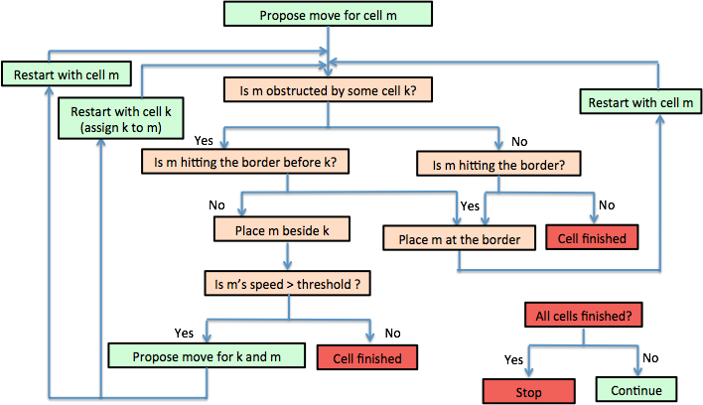
Cell Ballistics
9
Notes:
Once we know where the cell has to go, we can model its further behavior against walls or other cells. This algorithm explain the ballistics of the cell.
Explanation of the algorithm…

Slide 10
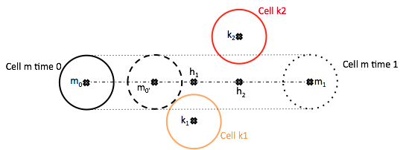
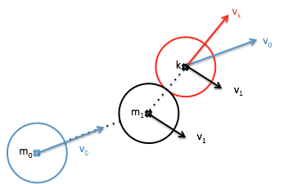
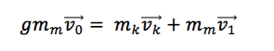
Cell-Cell Interaction
Cell m wants to move toward the right side but is obstructed by both Cell k₁ and k₂
10
Notes:
Here we provide you with more insight of cell interaction
This figures illustrates how we have detected a collision between cells but I am not going to explain the process as it is not very interesting.
However understanding how cell collides is far more pertinent. We have used a modulated pool ball model. Because cells rub against each other they loose energy. We have modulated the formula for the momentum conservation by a g factor. When a cell touches either a wall or another cell, the transmitted momentum is multiplied by this factor.

Slide 11
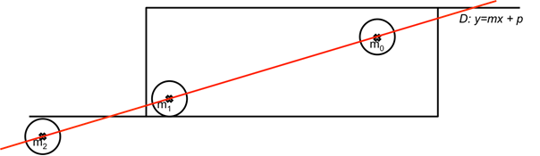
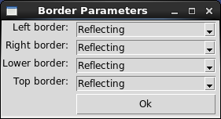
Cell-Wall interaction
11
Notes:
This figure illustrates how we have modeled a cell wall interaction. Cell m0 wants to move but is going to touch the wall before ending its move. The user can choose what kind of behavior he wants for the walls. It can be either killing, absorbing or reflecting. In the case of reflection, we put the cell at the border and change both its speed and its direction. We still use here the modulated pool ball model.

Slide 12
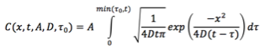
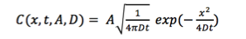
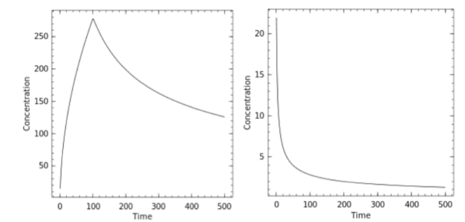
Diffusion
Sustained
Instantaneous
Plot of the concentration of ligands over time at a fixed distance from the source
12
Notes:
When a part of the body is injured, we have assumed that it will emit ligands. We assumed that those injuries will behave like ligand sources. We needed therefore to model the sources behavior. We have used two kind of diffusion:
Sustained
Unsustained

Slide 13
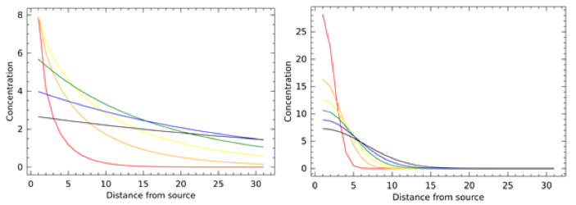
Diffusion Illustration
Plot of the concentration of ligands over distance at a fixed time for the sustained (left) and unsustained (right) models
13
Notes:
This illustrates the difference between sources behavior.

Slide 14
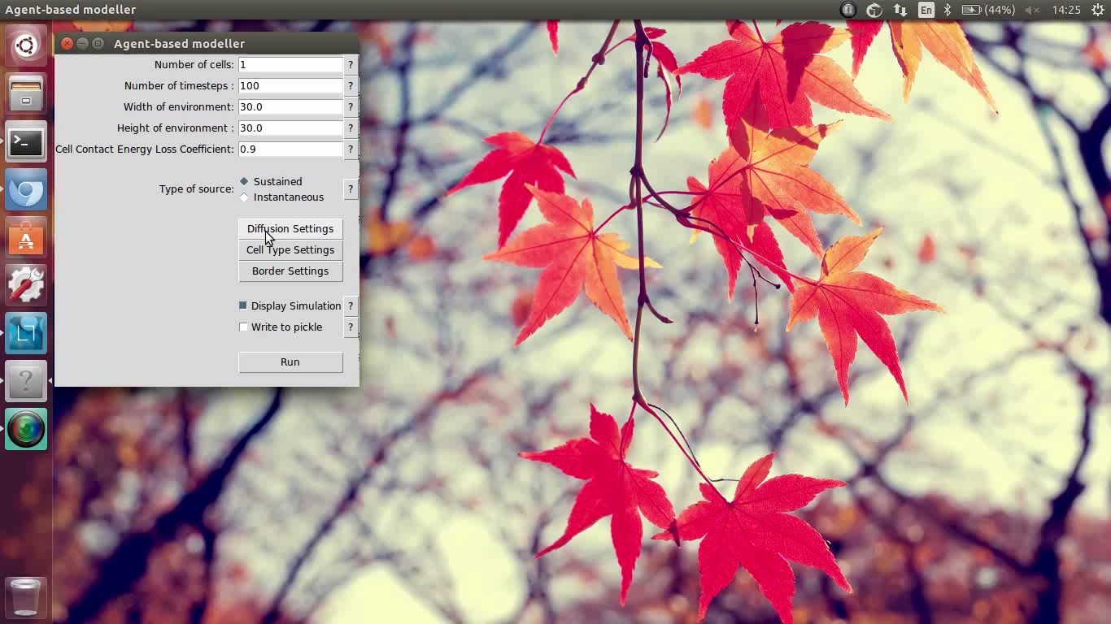
Diffusion Interface
14
Notes:
Video

Slide 15
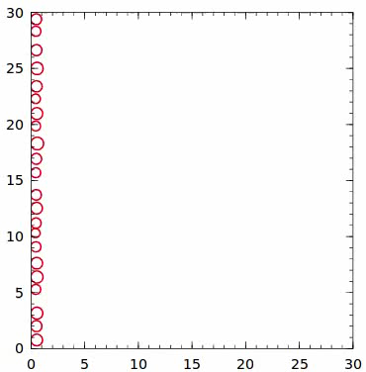
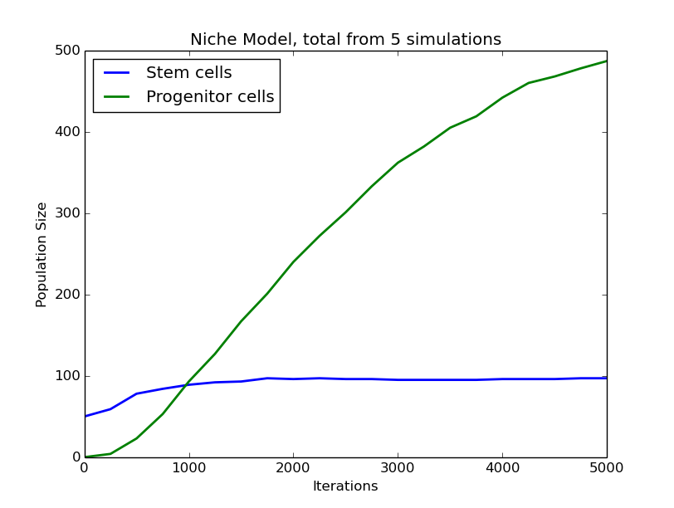
Example: Stem Cell Replication
15

Slide 16
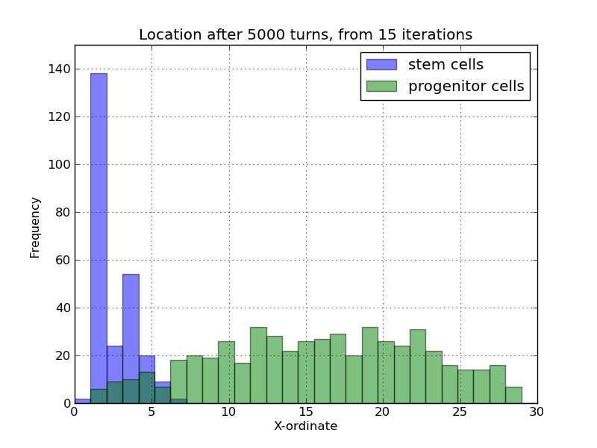
Example: Stem Cell Replication

Slide 17
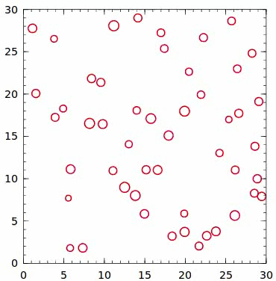
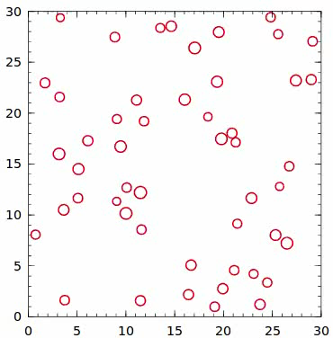
Example: Macrophage Migration

Slide 18
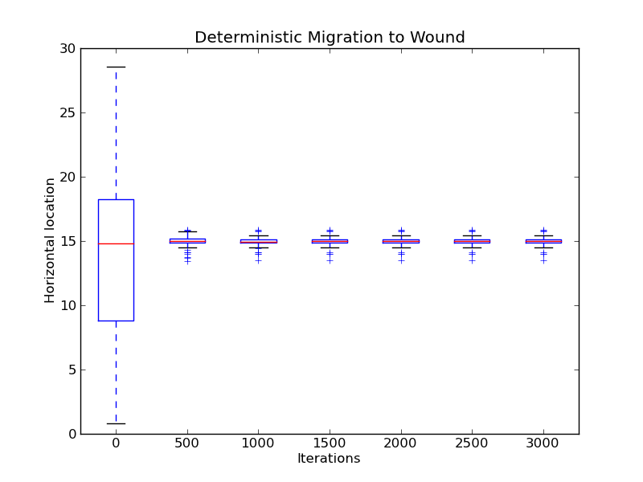
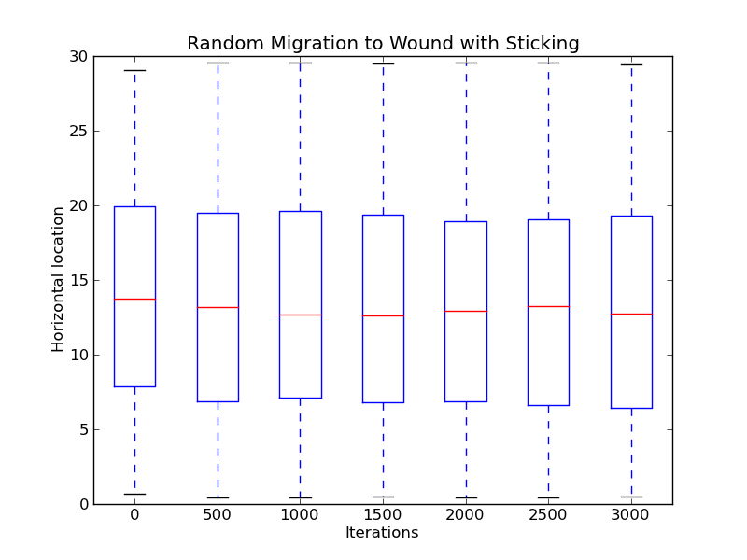
Example: Macrophage Migration

Slide 19
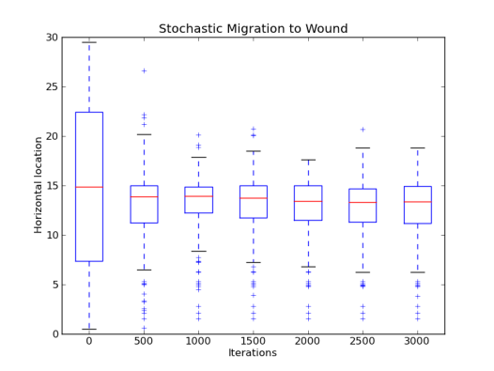
Example: Macrophage Migration

Slide 20
Further Directions
More sophisticated growth and death functions
More than one type of ligand per simulation
Inbuilt parameter inference suite

Slide 21
Conclusions
Design goals reached. Platform flexible and extensible
Can be used for exploratory analysis or data gathering
ABM basis allows for uniqueness

Slide 22
References
Kaul, Himanshu, and Yiannis Ventikos. "Investigating biocomplexity through the agent-based paradigm." Briefings in bioinformatics 16.1 (2015): 137-152.
Tisue, Seth, and Uri Wilensky. "Netlogo: A simple environment for modeling complexity." International conference on complex systems. 2004.
22

